Slide 1
Example: Distributed Array Access
P0
P1
P2
P3
Large array
distributed
among 16
processes
Each square represents
a subarray in the memory
of a single process
P4
P5
P6
P7
P8
P9
P10
P11
P12
P13
P14
P15
Access Pattern in the file
P0
P1
P2
P3
P0
P1
P2
P4
P5
P6
P7
P4
P5
P6
P8
P9
P10
P11
P8
P9
P10
P12
P13
P14
P15
P12
P13
P14

Slide 2
Level-0 Access (C)
Each process makes one independent read request for each row in the local array (as in Unix)
MPI_File_open(..., file, ..., &fh)
for (i=0; i<n_local_rows; i++) {
MPI_File_seek(fh, ...);
MPI_File_read(fh, &(A[i][0]), ...);
}
MPI_File_close(&fh);

Slide 3
Level-1 Access (C)
Similar to level 0, but each process uses collective I/O functions
MPI_File_open(MPI_COMM_WORLD, file, ..., &fh);
for (i=0; i<n_local_rows; i++) {
MPI_File_seek(fh, ...);
MPI_File_read_all(fh, &(A[i][0]), ...);
}
MPI_File_close(&fh);

Slide 4
Level-2 Access (C)
Each process creates a derived datatype to describe the noncontiguous access pattern, defines a file view, and calls independent I/O functions
MPI_Type_create_subarray(..., &subarray, ...);
MPI_Type_commit(&subarray);
MPI_File_open(..., file, ..., &fh);
MPI_File_set_view(fh, ..., subarray, ...);
MPI_File_read(fh, A, ...);
MPI_File_close(&fh);

Slide 5
Level-3 Access (C)
Similar to level 2, except that each process uses collective I/O functions
MPI_Type_create_subarray(..., &subarray, ...);
MPI_Type_commit(&subarray);
MPI_File_open(MPI_COMM_WORLD, file, ..., &fh);
MPI_File_set_view(fh, ..., subarray, ...);
MPI_File_read_all(fh, A, ...);
MPI_File_close(&fh);

Slide 6
Optimizations
Given complete access information, an implementation can perform optimizations such as:
  Data Sieving: Read large chunks and extract what is really needed
  Collective I/O: Merge requests of different processes into larger requests
  Improved prefetching and caching

Slide 7
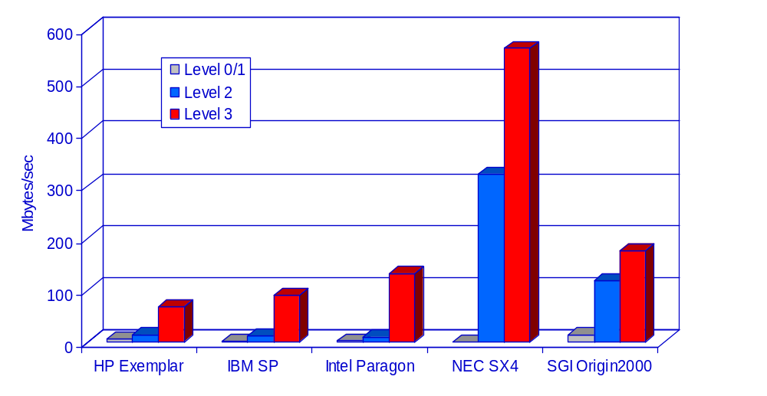
Distributed Array Access:
Read Bandwidth
64 procs
64 procs
256 procs
8 procs
32 procs
Array size: 512 x 512 x 512

Slide 8
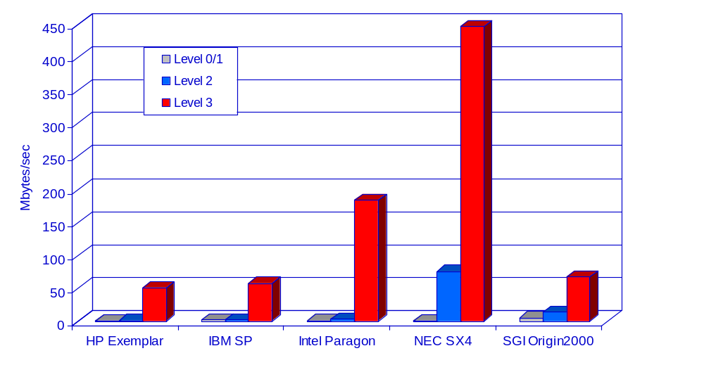
Distributed Array Access:
Write Bandwidth
64 procs
64 procs
256 procs
8 procs
32 procs
Array size: 512 x 512 x 512

Slide 9
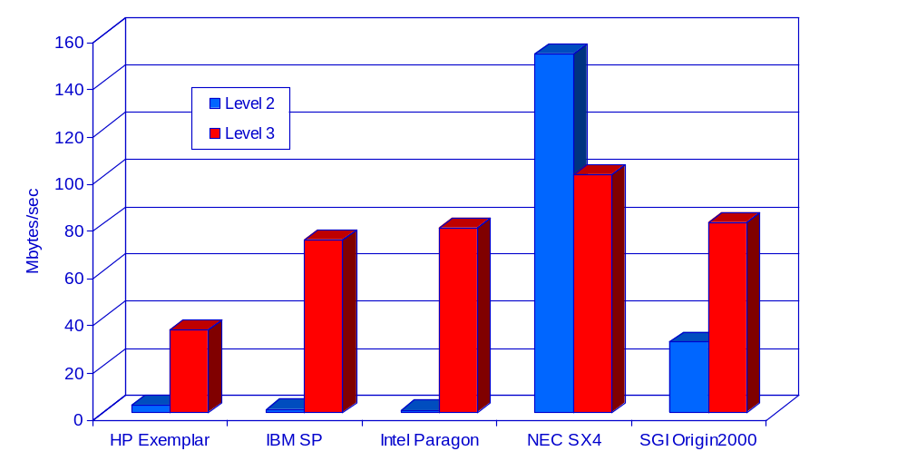
Unstructured Code:
Read Bandwidth
64 procs
64 procs
256 procs
8 procs
32 procs

Slide 10
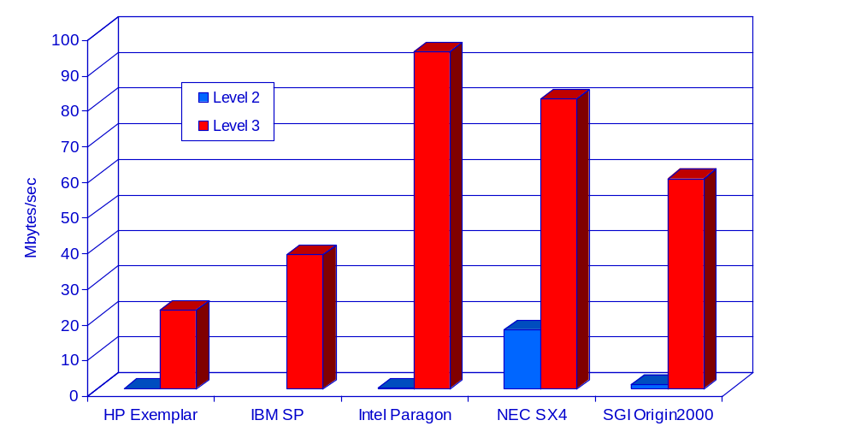
Unstructured Code:
Write Bandwidth
64 procs
64 procs
256 procs
8 procs
32 procs

Slide 11
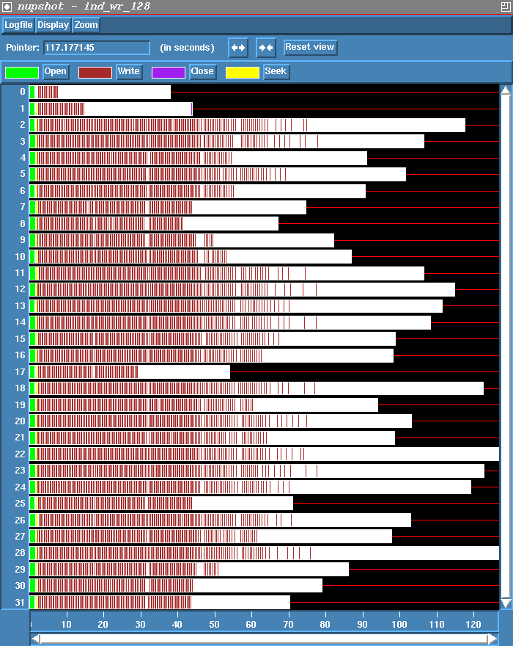
Independent Writes
On Paragon
Lots of seeks and small writes
Time shown =
130 seconds

Slide 12
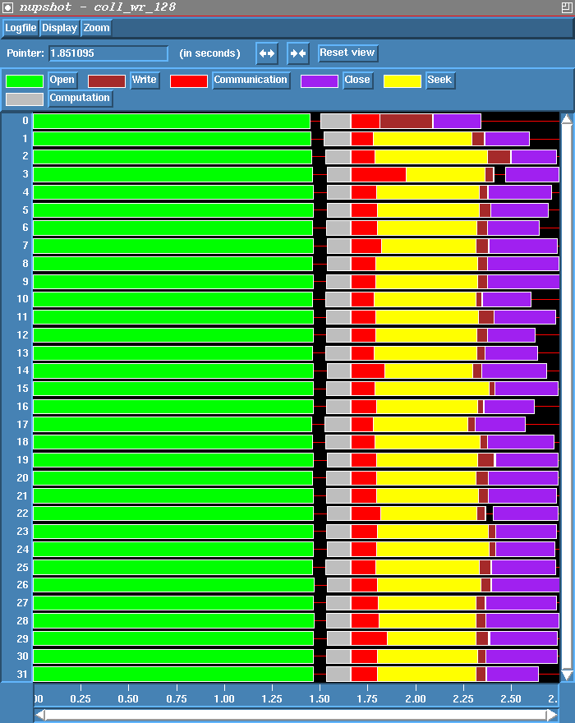
Collective Write
On Paragon
Computation and communication precede seek and write
Time shown =
2.75 seconds

Slide 13
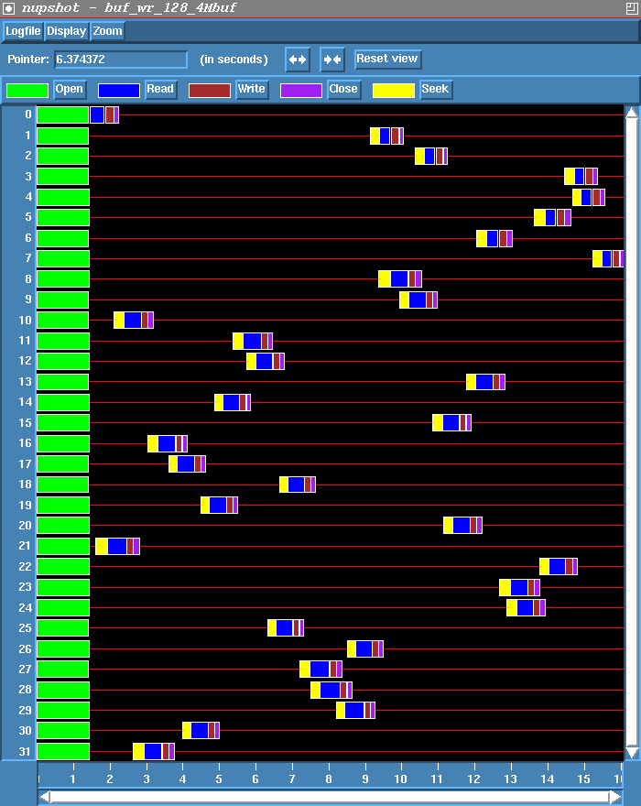
Independent Writes with
Data Sieving
On Paragon
Access data in large “blocks” and extract needed data
Requires lock, read, modify, write, unlock for writes
4 MB blocks
Time = 16 sec.

Slide 14
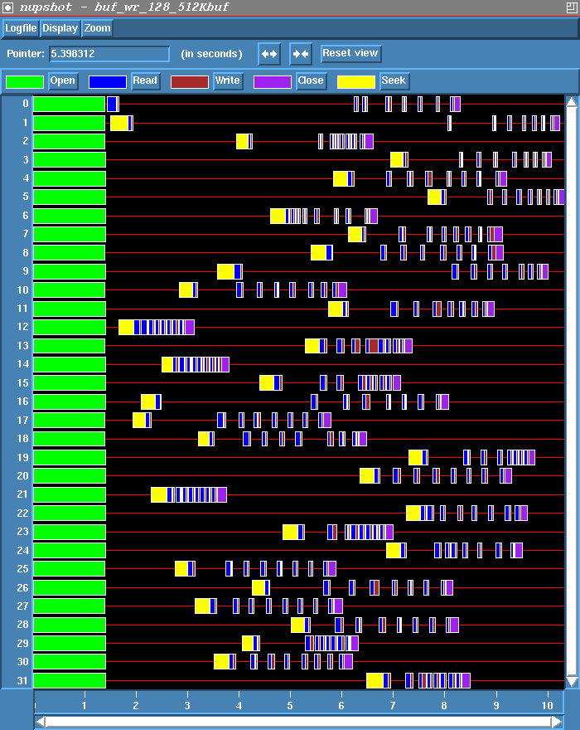
Changing the Block Size
Smaller blocks mean less contention, therefore more parallelism
512 KB blocks
Time = 10.2 seconds

Slide 15
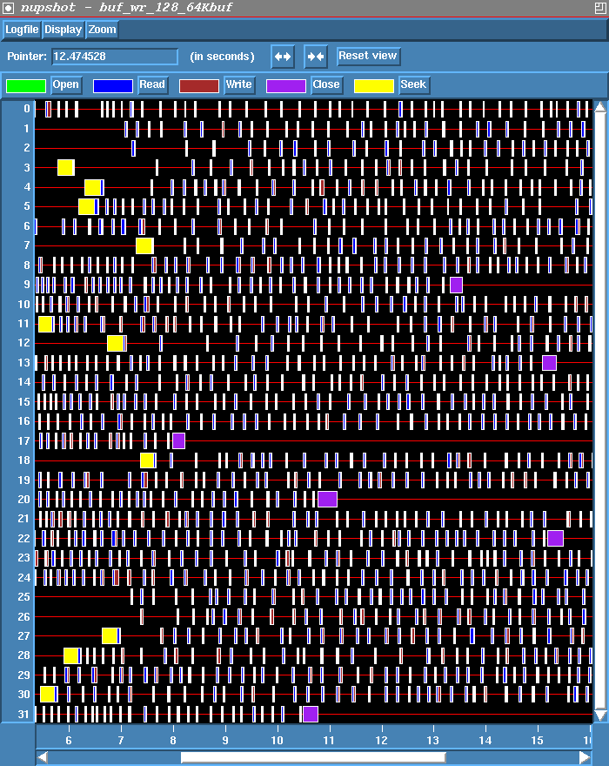
Data Sieving with Small Blocks
If the block size is too small, however, the increased parallelism doesn’t make up for the many small writes
64 KB blocks
Time = 21.5 seconds

Slide 16
Common Errors
Not defining file offsets as MPI_Offset in C and integer (kind=MPI_OFFSET_KIND) in Fortran (or perhaps integer*8 in Fortran 77)
In Fortran, passing the offset or displacement directly as a constant (e.g., 0) in the absence of function prototypes (F90 mpi module)
Using darray datatype for a block distribution other than the one defined in darray (e.g., floor division)
filetype defined using offsets that are not monotonically nondecreasing, e.g., 0, 3, 8, 4, 6. (happens in irregular applications)

Slide 17
Summary
MPI-IO has many features that can help users achieve high performance
The most important of these features are the ability to specify noncontiguous accesses, the collective I/O functions, and the ability to pass hints to the implementation
Users must use the above features!
In particular, when accesses are noncontiguous, users must create derived datatypes, define file views, and use the collective I/O functions

Slide 18
Related technologies
Hierarchical Data Format http://hdf.ncsa.uiuc.edu/
Network Common Data Format http://www.unidata.ucar.edu/software/netcdf

